Slide 1
XXXXXXXXXX Work Project
Created by Shashank Sharma

Slide 2
Agenda
Executive Summary
EDA
Improving Customer Base
Next Steps
Appendix

Slide 3
Agenda
Executive Summary
EDA
Improving Customer Base
Next Steps
Appendix

Slide 4
Executive Summary
Delimiter was present inside data fields and was creating problem as raw data was not delimiter sensitive
There were duplicate records which were removed after fixing the delimiter problem
Data Cleaning
Findings
Insights
Strong customer base with ~25K active customers. Over 60% using Enterprise plan (slide 6)
~246.5K jobs in 48 different categories. Sales & Biz Dev” and “Healthcare” have ~40% postings (slide 6)
419 distinct MSA regions for postings. Coastal regions and Texas have ~80% job openings (consolidate core market of Texas) (slide 11)
“CLOSE_REASON” is missing for ~92% job postings closed recently (increase engagement throughout the value chain from posting to closure) (slide 6)
Top 27 users have posted more than 1,000 jobs/user. Customized plan is needed for top users and seasonal users (slide 9)
Strong presence on west coast and mid-west region. Should consider east coast region for new office (slide 11)
Further customizations should be made to the platform and billing methods for overall improvement (slides 8,9, 10)
Approx. 91% postings got less than 20 applications. Needs more attention (base needs to be covered) (slide 15) (assumption 3)
Findings and Insights
Conducted a 2 question brand awareness survey about XXXXXXXX across WP Carey (hyperactive job seekers) (assumption 2)
~44% knew about XXXXXXXX and only ~31% of them use XXXXXXXX services regularly. Needs further evaluation (ANOVA test @ multiple universities) (assumption 4)
Introduce smart search to reduce “not-enough-candidates” count (slide 15)
Become an essential platform for clients by engaging them end to end in the hiring chain (slide 16)
Next Steps
***Assumptions slide in Appendix

Slide 5
Agenda
Executive Summary
EDA
Improving Customer Base
Next Steps
Appendix

Slide 6

1
EDA
~25k users have posted ~246.5K jobs in 48 major categories. More than 60% users have subscribed to Enterprise plan. Most of the postings are close to east & west coast
“POSTED_BY_USER_ID”: ~25k users have posted ~246.5K jobs
Top 1% users post ~51% jobs
Top 27 users have posted more than 1,000 jobs/user
“PLAN_TYPE”: 7 different plan types
Enterprise plan is being used by ~60.5% users
76% of top 1% users use Enterprise plan
“CLOSE_REASON”: Missing for ~92% records
Out of remaining ~8%, ~12% “found-ziprecruiter-candidates”
“MSA_NAME”: 419 distinct MSA regions (including “”)
East & West coastal regions and Texas have ~80% job openings
“JOB_CATEGORY”: 48 major job categories
“Sales & Biz Dev” and “Healthcare” have ~40% postings
Top 14 categories have more than 80% of total postings

Slide 7
2
EDA
“CLOSE_REASON” is missing for ~92% job postings, resulting in a major communication gap between XXXXXXXX and clients
CLOSE_REASON | # | %
”” | 90,635 | 92.46%
other-reason | 5,018 | 5.12%
not-enough-candidates | 863 | 0.88%
found-ziprecruiter-candidates | 911 | 0.93%
candidates-under-qualified | 599 | 0.61%
Total – Jobs Closed | 98,026 | 100.00%
This might be the biggest gap in the value change (further explored in slide 16)
1
Efforts should be made to reduce this number by introducing smart search (slide 15)
2
What is the main reason behind these missing values?
This could be due to the job opening itself or some internal product or service restrictions

Slide 8
3
EDA
Cap on resume downloads is the biggest limitation of the service. Efforts should be made to find a way around this
Plans and their features
Limitations
Possible solutions
Plan Information and Features **
Plan | Resumes Downloads | Posting Slots
Applications per posts | #
[0,20) | 91,373
[20,50) | 5,164
[50,100) | 1,112
[100,500) | 375
>=500 | 2
 | 98026
First 20 resume downloads can be free
A fix amount can be charged for >20 downloads ($xx)
The pricing can be split into two parts

Slide 9
4
EDA
More customized plans should be available for the top and returning users. Job seekers could be charged a nominal fee for priority based resume display
Plans and their features
Limitations
Possible solutions
POSTED_BY_USER_ID | Posts | Cumulative | Cumulative %
159969 | 10,643 | 10,643 | 4.32%
159074 | 7,487 | 18,130 | 7.36%
356784 | 6,199 | 24,329 | 9.88%
390098 | 5,939 | 30,268 | 12.29%
A more customized plan should be created for the top users
Since seasonal recruitment scenarios are likely, a better plan should be there for returning users (assumption 5)
Job seekers could be charged a nominal fee ($xx per year), for priority based resume display in selected domains (e.g. Analytics)
…
…
…
…
558501 | 1 | 246,312 | 100.00%
685838 | 1 | 246,313 | 100.00%
646196 | 1 | 246,314 | 100.00%
310209 | 1 | 246,315 | 100.00%

Slide 10


5
EDA
Plans and pricing could be further customized to attract and retain more customers. New schemes could be introduced for resume downloads, top users, returning users, job seeker priority resume display
Plans and their features
Limitations
Possible solutions
Customized plan for top users
Plan for seasonal users
Limitation on Resume Downloads
Nominal fee from end user for priority display
Other Plans
Legacy Plan
Company Plan
Team Plan
Starter Plan
Big Plan
Enterprise Plan

Slide 11
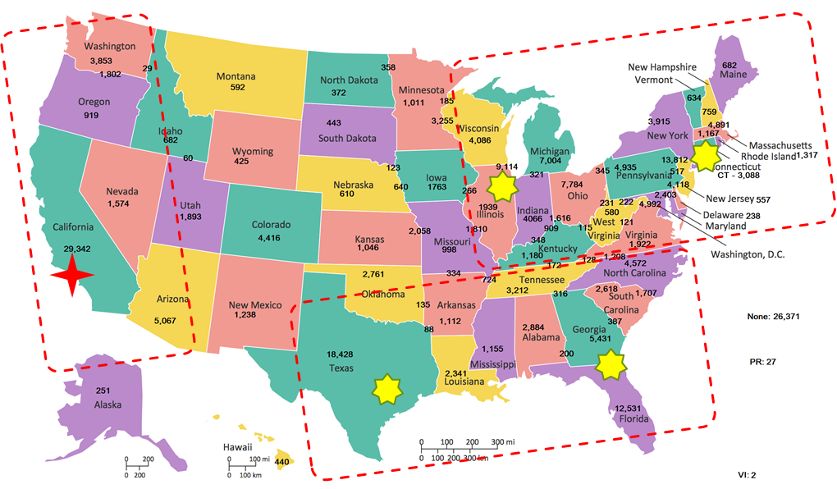
6
EDA
XXXXXXXX have strong presence on west coast and mid-west region. There should be a sales office on the east cost to provide field sales coverage
Decision Variable: Field hubs
Objective:
Maximize {Field coverage + Risk Diversification¹}
Constraints:
Minimized Expenditure
Existing Offices
Recommended Hubs
1. e.g. Tech (SFO) vs Banking (NYC) - cyclical lags of the two industries helps diversify risks

Slide 12
Agenda
Executive Summary
EDA
Improving Customer Base
Next Steps
Appendix

Slide 13

Focus on brand promotion and predicting number of applications / $ for an incoming application to attract more clients
(Small Survey @ ASU):
Sample Size of more than 250 was taken
Used “Random sampling without replacement” to select students from different programs graduating this year
66 Students responded and were chosen for the statistical evaluation
Key KPI for Clients
(External Platforms) Indirect Applications
Raw Data
PLAN_TYPE
Predicting # of Applications
XXXXXXXX
MSA_NAME
STATE_AREA
(Applications / $)
JOB_CATEGORY
JOB_TITLE
DOCUMENT TERM MATRIX
DAYS_JOB_LIVE

Slide 14
Agenda
Executive Summary
EDA
Improving Customer Base
Next Steps
Appendix

Slide 15











1
Reactive to Inductive Mode
A cognitive (ML based) resume search can be implemented. Hiring managers could be charged $xx every time they use this service to predict candidates “actively seeking” AND “likely to join” (NLP and Classification)
Hiring Manager
Candidates
1
Job Posting
Current State
Reactive in Nature
Apply Online
2
Resumes
3
1
Job Posting
Upload Resume
1
Recommended State
Inductive in Nature
Resumes
3
Apply Online
2
Feedback
Enable keyword based search which uses resume database and recent job activity as input combined to return hyperactive candidates as output
NLP
Cognitive Search
Resume and Job Activity
Hiring Manager’s could be charged $xx per use (limited search results < xx)
Collects feedback as hiring managers select and download resumes

Slide 16




2
Engagement in Value Chain
Become a necessity for XXXXXXXX clients by engaging them throughout the hiring chain(i.e. from job posting to closure). The aim is to become strategic (i.e. constant engagement) vs transactional (one dimensional)
Hiring Value Chain
Hiring Manager
Candidates
Candidate Profile
1
Job Posting
Apply Online
2
Resumes
3
Application
XXXXXXXX is currently not involved at the closure stage. This multilevel constant engagement should change that; along with creation of digital assets and associated data
?
Phone Interview
?
Coding Platform
Record Data at each level and use it like an asset
Data is a strategic asset to XXXXXXXX which should be used as a revenue resource
Selection Process
?
Online Exam
Recruitment (Closure)
?
Video Interview

Slide 17
Appendix
Data Preprocessing
Assumptions

Slide 18
1
Data Preprocessing
Raw data wasn’t delimiter sensitive which was affecting 860 rows while importing. ~4.6K duplicate rows have been removed after fixing the delimiter problem
The input data is not delimiter sensitive
860 rows were affected by the presence of delimiter in “JOB_TITLE” field
There are duplicate records in the input data
After removing duplicates, # observations = 246,315 from initial # = 250,956
Insights
Prescriptive System
EDA
Users have subscription to
multiple plans

Slide 19
Assumptions
Assuming billing cycle (resume download restriction)
Assuming target market is recent job seekers
“Applications” count – Numbers are derived from XXXXXXXX Portal and not from other sites
Limited responses on survey
Small firms (10 – 50 employees) will hire once a year

